Slide 1
Industrial Engineering
& Management lesson(1)

Slide 2
Contents
➢ Study of Industrial Management
➢ Production
➢ Engineering Economics
➢ Maintenance Management
➢ Depreciation
➢ Quality Assurance
➢ International Organization For Standardization (I.S.O)

Slide 3
Management: - The planning, organizing, leading, and controlling of human and other resources to achieve organizational goals effectively and efficiently.
Managers: - The people responsible for supervising the use of an organization’s Resources are organizational assets:-
➢ People ➢Skills ➢Knowledge ➢Information
Raw materials ➢Machinery ➢Financial capital
Efficiency, Effectiveness, and Performance in an Organization sources to meet its goals.

Slide 4
Organizational Performance:-A measure of how efficiently and effectively managers are using organizational resources to satisfy customers and achieve goals.
• Efficiency :-A measure of how well or productively resources are used to achieve a goal.
• Effectiveness:- A measure of the appropriateness (suitability) of the goals an organization is pursuing and the degree to which they are achieved.

Slide 5
Study Management
Proper management directly impacts improvements in the well-being of a society.
• Studying management helps people to understand what management is and prepares them accomplish managerial activities in their organizations.
• Studying management opens a path to a well-paying job and a satisfying career.

Slide 6
Production
production can be defined as follows;
Production is a sequence of technical processes, requiring either directly or indirectly the mental and physical skill of craftsman and consists of changing the shape, size and properties of materials and ultimately converting them into more useful articles.
Production includes manufacture of goods and services, and they are four recognized factors for this procedure:
1- Natural resources including land
2- Labour.
3- Capital i.e. factory building, machinery, tools, raw materials….etc.
4- Organization

Slide 7
A simple production system is shown in the following figure;

Slide 8

Production function: Most important task of the production
management is to deal with decision making related to production
processes so that the goods manufactured are according to the specifications, in the required quantity, at minimum cost as per schedule.
A popular production function derived by Mr. Cobb and Mr. Douglas is
as follows:    1
Where p = Total output.
L = Index of employment of labour in actual manufacturing.
C = Index of fixed capital in manufacturing.
α and 1 – α are known as elasticities of production and measured in a percentage.

Slide 9
Types of production : Different types of production can typically be
placed under two categories:
1- Intermittent production.
2- Continuous production.
In intermittent production, machinery is used for a short duration of time for producing an item, and then changed to produce another item.

Slide 10
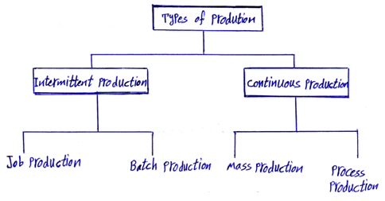
While in continuous production, set up of production is fixed and used to produce same item.
FIG-2 Types of production

Slide 11
(a) Job production :
This is the oldest method of production on a very small scale. With this method individual requirements of the consumers can met. Each job stands alone and is not likely to be repeated. This type of production has a lot of flexibility of operation and hence general purpose machines are required. Factories adopting this type of production are generally small in size. This type of production is used for things which cannot be produced on a large scale.
Advantages:
1- It is the only method which can meet the individual requirements.
2- There is no managerial problem because of very less number of workers.
3- This type of production required less money and is easy to start.
4- There is less risk of loss to the factory adopting this type of production.
5- Because of flexibility, there is no chance of failure of factory due to the reduction of demand.

Slide 12
Disadvantages:
1- There is no scope of commercial economy.
2- As the purchase of raw materials is in less quantity, hence cost of raw materials is slightly more.
3- For handling different type of jobs, only skilled and intelligent workers are needed, thus labour cost increases.

Slide 13
(b) Batch production
This type of production is generally adopted in medium size enterprises.
Batch production is a stage in between Job production and Mass production. Batch production is bigger in scale than the Job production while it is smaller than that of Mass production. Batch production required more machines than that of Job production and less machines than that of Mass production. As in this type of production, two or more types of products are manufactured in lots (i.e. batches) at regular interval, therefore this is known as Batch production. Most of the engineering concerns are adopting Batch production.
Advantages:
1- While comparing with mass production it requires less capital.
2- If demand for one product decreases then production for another may be increased, thus the risk of loss is very less.
3- Comparing with job production, it is more advantageous commercially.

Slide 14
Disadvantages:
1- Comparing with mass production, cost of sales and advertisement per unit is more.
2- Raw materials to be purchased are in less quantity than in mass production. Therefore, it is slightly costlier than of mass production.

Slide 15
(c) Mass production
This type of production is a larger scale production and is a continuous production.
In job production, factory works only when orders are received and when orders are not received for some time then for that period work may come to a standstill.
But mass production is a continuous production and it does not have any non-producing time. In this method with the use of automatic machines, articles automatically move forward from one stage to the next stage of manufacturing operation. In mass production, simplification and standardization of products are made.
In this type of production, different machines are assigned a definite nature of work. Throughout the run of the plant, only one type of product can be manufactured.

Slide 16
Advantages:
1- Mass production gives better quality and increased production.
2- Wastage is much minimum.
3- As raw materials are purchased on a large scale, higher margin of profits are available, while purchasing them.
4- Sales promotion and advertising do not prove to be costly as their expenses are spread over thousands of articles produced, hence cost per unit is low.
5- Only few skilled and rest semi-skilled workers are required hence labour cost is reduced.
Disadvantages:
1- During the period of less demand heavy losses on the invested capital may take place.
2- Because of all the machines used are one purpose machines therefore, this type of production is not changeable to other type of production.
3- Most of the workers handle only particular operation. They may get skill in their job but after sometime they feel bored with the repetition of same type of work.
4- As this type of production is on large scale, consequently it cannot fulfill individual taste. It produces things of standardized from which are demanded on a large scale.

Slide 17
(d) Process production :
In this type of production, the plant and its equipment and layout have been primarily designed to manufacture the desired product. Examples of such production are automobiles, chemical plants, fertilizer plants etc. Unlike other production systems, switch over to other product is very difficult and costly affair especially when special.
Industrial or production management
Production management is a branch of general management which is concerned with production activities.
Operation management can be defined as the management of the conversation process, which converts land, labour, capital, and management inputs into desired outputs of goods and services.

Slide 18
Scope of production management:-
1. Relating to designing of production system: these activities concern the production engineering, and include design of tools and jigs ; design, development and installation of equipment, and selection and optimization of the size of the firm. Selection of plant location, plant layout, materials handling systems are functions of production engineering. The problems of human factor, and research and development are also considered.
2. Relating to analysis and control of production operation: these activities include production planning, production control. Production control activities are looked after at three levels: control of inventory, control of flow of materials, and control of work -in- progress. Other controls to be looked into are quality control, cost control and labour control.

Slide 19
Value added process
All operations add value to the object thereby enhancing its usefulness. In view of this, we can define an operation as "the process of changing inputs into outputs and thereby adding value to some entity".
Systems approach to production management
A system can be defined as an orderly arrangement of components like, men, materials, money, machine and environment that are inter-related and act and interact with one another to perform task or function in a particular environment.
A system is composed of elements or sub-

Slide 20
systems that are related and dependent upon each other. A systems approach is a systematic and organized approach to get the task accomplished more efficiently, effectively and economically. A system can be considered as a structure of sub-system, each having the following characteristics:
(a) Inputs
(b) Transformation( conversation) process
(c) Output
(d) Feed back

Slide 21
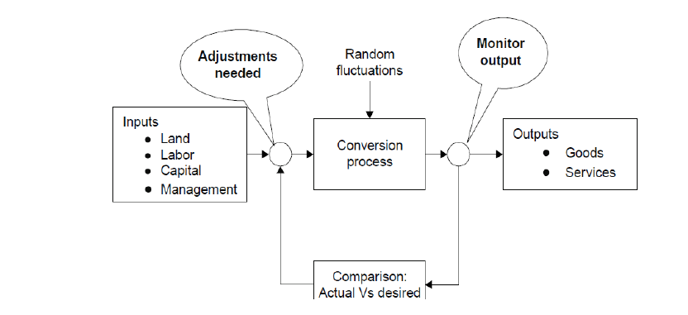
FIG-3 Conceptual model of production management

Slide 22
A systems model of the organization has several sub-systems as shown in the below figure.
Any business organization has finance, marketing, accounting, personnel, engineering, purchasing, and distribution systems besides operations system.
All these systems are interrelated to one another in many ways.

Slide 23
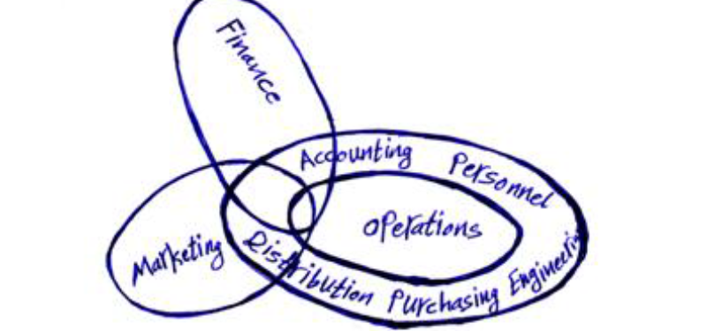
Figure (3) A systems view of a business organization indicating its sub-systems

Slide 24
Production Competitiveness in function
In order to compete in the global market, there are four dimensions of competitiveness that measure the effectiveness of the production function. These four dimensions are:
1. Cost
2. Quality
3. Dependability as a supplier
4. Flexibility

Slide 25
1-Cost :-Price is an important weapon used in the competitive market place. Profitability is also related to the difference between price and cost. Therefore, in order to compete on the basis of price, operations function must be capable of producing at low cost
2-Quality :-Due to Japanese concept of quality and dominance of Japanese market in consumer electronics, automobiles, steel, machine tools etc., more attention is being paid now-a-days on quality.
3- Dependability as a supplier Dependability of supply of off-the-shelf availability is considered as a strong favorable point in competitive market for an organization. Customers, sometimes,may compromise on cost or quality in order to get on –time delivery when they need it.
4- Flexibility A firm must be flexible enough to meet customers' needs. Customers needs may be about service, change in specifications, change in delivery schedule etc.

Slide 26
Productivity
"Productivity" is nothing but the reduction in wastage of resources. The resources may be men, machines, material, power, time and building space etc.
It may also be defined as human Endeavour (Effort) to produce more and more with less and less inputs of resources as a result of which the benefits of production may be distributed more equally among maximum number of people

Slide 27
Difference between Production and Productivity
Sometimes, there arises confusion between production and productivity. It is, therefore, necessary to differentiate them, so that there may not be any confusion.
"Production" of any commodity or service is the volume of output irrespective of the quantity or quality of resources employed to achieve that level of output. Once we put in it element of efficiency with which the resources are employed, we enter the area of productivity

Slide 28
Qualities of good industrial management
A good industrial management is that which can steer through different problems and is capable of achieving its fixed targets. Some of the important qualities of the management are:
1- Collection and analysis of data. It should go on collecting the data about the products, its manufacturing including trends of sales, availability of raw materials etc.
2- Proper research. It should have properly equipped research wing.
3- Not too-rigid. Management should always be prepared to review its decisions.
4- Not too much centralization. As far as possible management should avoid over centralization.

Slide 29
5- Division of labour. The management should be in a position to properly divide the available man-power in such a way that there is no wastage or there is no over-lapping.
6- No wastage. Good management is expected to avoid wastage as far as possible, whether it may be human resource or material. It should see that money is spent in such a way that maximum profits are available to the industry.
7- Proper control. Good management is supposed to exercise discipline and controls over employees and over –expenditure.
8- Stress on training. Management should ensure that the employees at all the levels got refresher and in service training to keep their knowledge up to date.
9- Contacts with the employees. Employees are the life and blood of an organization. Hence management should have both formal and informal contacts with the employees.

Slide 30
FIG-5 Functions of industrial / production management

Slide 31
Major functions covered in the production management system are as follows:
A- Planning :- Planning is the main function of management. All other functions follow the planning function.
(a) Designing conversion systems.
- Operations strategy
- Forecasting
- Product and process selection
- Capacity planning
- Facility location planning
- Layout planning
(b) Scheduling conversion systems
- Scheduling systems
- Aggregate planning
- Operations scheduling

Slide 32
Planning
• Identifying and selecting appropriate goals and courses of action for an organization.
➢ The planning function determines how effective and efficient the organization is and determines the strategy of the organization.
• Three Steps in the Planning Process:
➢ Deciding which goals to pursue.
➢ Deciding what courses of action to adopt.
➢ Deciding how to allocate resources

Slide 33
Advantages of planning
Following are some of the main advantages of proper planning:
-planning gives direction.
-planning helps to offset change and uncertainty.
-planning helps in economic operation-planning focuses attention on important activities in order to fulfill its objectives
-planning helps in control.
-planning helps in growth.

Slide 34
B- Organization:- Organizing is an important function of management by which it combines the human power with other resources to give desired output .The process of organization is a managerial function of organizing, and Involves determination of objectives, deciding various activities, grouping of activities, assignment of responsibilities, delegation of authority, providing facilities and proper environment.
Organization is an identifiable group of people contribute their efforts towards the attainment of goals.

Slide 35
Characteristics of a good organization
1- Purposeful i.e. to accomplish an objective.
2- Boundaries and limitations. Limits imposed by resources and environment.
3- Interdisciplinary
4- Empirical i.e. based on real world observations and interactions.
5- Make use of information.
6- Decision oriented.
7- Feedback oriented.
8- Responsive and learning oriented.
9- Adaptive.

Slide 36
Organizational Structure
➢ A formal system of task and reporting relationships that coordinates and motivates organizational members.
➢ Creating organizational structure:
• Grouping employees into departments according to the tasks performed.
• Laying out lines of authority and
responsibility for organizational members.

Slide 37
C- Leading
1- Staffing For a new enterprise, staffing function is followed by planning and organizing functions. Staffing function comprises, the activities essential to manage and keep manned the positions created by the organization structure.
2- Directing is a function which includes all those activities which are designed to encourage subordinates to work effectively both in short and long run.
• Articulating a clear vision to follow, and energizing and enabling organizational members so they understand the part they play in attaining organizational goals.
➢ Leadership involves using power, influence, vision, persuasion, and communication skills.
➢ The outcome of leadership is highly motivated and committed organizational members.

Slide 38
D- Controlling
Controlling is a continuous process of measuring actual results in relation to those planned. Controlling can also be defined as that managerial activity whereby the manager compares actual performance against the planned one, fined out the deviation, and take corrective actions.
Controlling function of the management has following four main elements:
(i) Establishing standards of performance.
(ii) Measuring current performance.
(iii) Comparing performance with the established standards.
(iv) Taking corrective action, if any deviation is detected.
• Evaluating how well an organization is achieving its goals and taking action to maintain or improve performance.
➢ Monitoring individuals, departments, and the organization to determine if desired performance standards have been reached.
➢ Taking action to increase performance as required.

Slide 39
Types of industry:-
Industry is that part of the business activity which concerns itself with the production, processing or fabrication of products. The products may be consumer goods, capital goods or intermediate goods (like aluminum, copper, steel, plastic etc.) broadly the industries can be divided into four types: هو جزء من النشاط التجاري الذي يهتم بإنتاج المنتجات أو تصنيعها أو تصنيعها. قد تكون المنتجات السلع الاستهلاكية والسلع الرأسمالية أو السلع الوسيطة (مثل الألومنيوم والنحاس والصلب والبلاستيك وما إلى ذلك) على نطاق واسع يمكن تقسيم الصناعات إلى أربعة أنواع

Slide 40
1.Extractive industries. The commodities raised by such industries are produced with comparatively little assistance from man. الصناعات الاستخراجية. يتم إنتاج السلع التي تثيرها هذه الصناعات بمساعدة ضئيلة نسبيا من الرجل
2. Genetic industries. These industries are engaged in reproducing and multiplying certain species of plants and animals with the object of earning profit from their sale. For example, nurseries, cattle bearing farms, poultry farms etc. الصناعات الوراثية. وتشارك هذه الصناعات في إعادة إنتاج وتكاثر أنواع معينة من النباتات والحيوانات بهدف جني أرباح من بيعها. على سبيل المثال ، دور الحضانة ومزارع تربية الماشية ومزارع الدواجن إلخ
3. Construction industries. These involve construction of buildings, roads, canals, dams, bridges etc. البناء. وتشمل هذه بناء المباني والطرق والقنوات والسدود والجسور الخ
4. Manufacturing industries. Generally the term industry is used to refer to manufacturing industries (which is not correct). Manufacturing industries are engaged in the conversion or transformation of raw materials or semi-finished products into finished products. These may be Analytical industries, Synthetic industries, Processing industries or Assembly –line industries. The industries are sometimes classified on the basis of size and investment, such as heavy industries or light industries. الصناعات التحويلية. عموما يستخدم مصطلح الصناعة للإشارة إلى الصناعات التحويلية (وهذا غير صحيح). وتشارك الصناعات التحويلية في تحويل أو تحويل المواد الخام أو المنتجات شبه المصنعة إلى منتجات تامة الصنع. قد تكون هذه الصناعات التحليلية ، والصناعات الاصطناعية ، والصناعات التحويلية أو الصناعات التجميعية. تصنف الصناعات في بعض الأحيان على أساس الحجم والاستثمار ، مثل الصناعات الثقيلة أو الصناعات الخفيفة

Slide 41
Charts for medium and large industry:
Organization charts for medium, and large industries are given hereunder. However these can vary from organization to organization depending upon the factors.
(a) For medium industry. For a medium size industry, a sample chart for management is given at following figure. Layout given in that figure is for a medium sized concern controlled by the board of directors, who act through a managing director. Here the activities of the concern are divided into various sections namely: sales, office, works, inspection and design, with a departmental head in each. بالنسبة إلى صناعة متوسطة الحجم ، يتم إعطاء نموذج مخطط للإدارة على الشكل التالي. المخطط المعطى في هذا الرقم هو لقلق متوسط الحجم يسيطر عليه مجلس الإدارة ، الذي يعمل من خلال مدير إداري. هنا تنقسم أنشطة الاهتمام إلى أقسام مختلفة وهي: المبيعات ، والمكاتب ، والأعمال ، والتفتيش والتصميم ، مع وجود رئيس إداري في كل قسم.

Slide 42
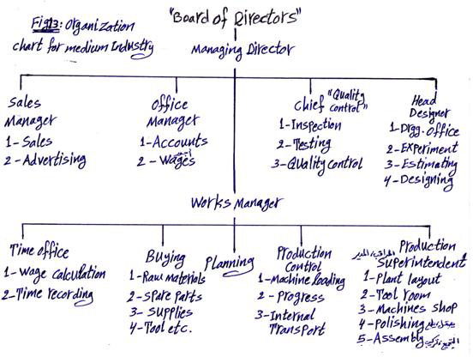
Fig : Organization chart of medium industry

Slide 43
This structure is designed to permit the managing director some help from over – work of his authority while still handling control.
In this manner, he is free from handling too much detail and from being brought into contact with large number of people.
Main works to be done in each department are given in the chart with the designation of the head. تم تصميم هذه البنية للسماح للمدير الإداري بالمساعدة من الإفراط في العمل في سلطته مع الاستمرار في السيطرة.
وبهذه الطريقة ، فهو حر من التعامل مع الكثير من التفاصيل ومن الاتصال بعدد كبير من الأشخاص.
يتم إعطاء الأعمال الرئيسية التي يتعين القيام بها في كل قسم في الرسم البياني مع تعيين الرأس.

Slide 44
(b) For large industry. A sample organization chart for a large concern is shown in the following figure. It may have necessary alterations to meet the requirements for a particular industry.
In this chart, the activities of the concern are divided into six main sections. Each having a head who is responsible to and is in direct contact with the managing director or general manager as the case may be.

Slide 45
Each sphere of the activity is fairly well designed and the risks of overlapping of activities are avoided. In very large organizations, there may be 2 or 3 sections under each general manager, who works under managing director.
None of the chief official is required to make contact with large number of people.
This does not mean that the heads are unapproachable.
What does it mean that they do not waste time asking number of persons for information

Slide 46
which they can get from the planned sources? The scheme is designed to make use of the skill and the time of the officials to the best advantages and to free them from handling a mass of details.

Slide 47
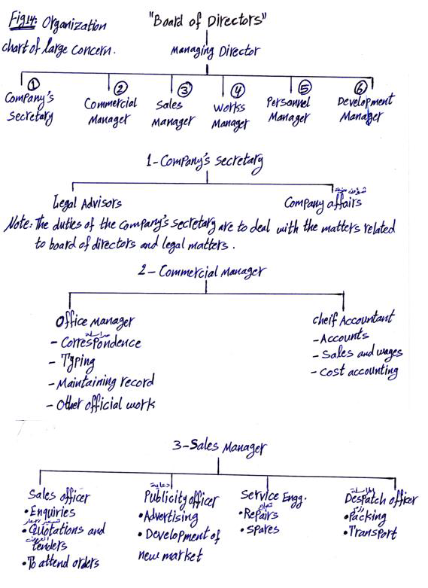

Slide 48
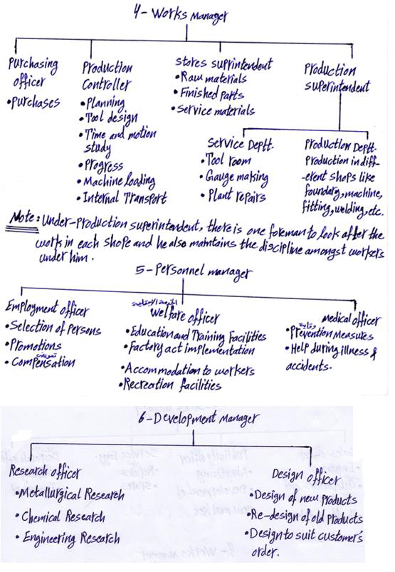
Fig 12: Organization chart of large concern

Slide 49
PROCESS ENGINEERING ECONOMICS
Economics is ever present in our lives because we earn money from our jobs and we spend money allocated by our personal budgets for housing, clothing, transportation, entertainment, etc. We spend money for these items based upon the perceived economic utility. Further, economics is the engine that drives industry. الاقتصاد موجود على الدوام في حياتنا لأننا نحصل على المال من وظائفنا وننفق الأموال المخصصة من خلال ميزانياتنا الشخصية للإسكان ، والملابس ، والنقل ، والترفيه ، وما إلى ذلك. نحن ننفق الأموال على هذه البنود على أساس المنفعة الاقتصادية المتصورة. علاوة على ذلك ، الاقتصاد هو المحرك الذي يدفع الصناعة
Chemical engineers in the performance of their jobs will employ economics in the preparation of capital cost estimates, operating expense estimates, profitability analyses including the time value of money, feasibility studies, and to perform sensitivity and uncertainty analyses considering many alternatives. To move up the management ladder, they must have a working knowledge of balance sheets, income statements, and financial analyses of a corporate venture. سيقوم المهندسون الكيميائيون في أداء وظائفهم بتوظيف الاقتصاد في إعداد تقديرات تكلفة رأس المال ، وتقديرات النفقات التشغيلية ، وتحليلات الربحية بما في ذلك القيمة الزمنية للنقود ، ودراسات الجدوى ، وإجراء تحليلات الحساسية وعدم اليقين بالنظر إلى العديد من البدائل. ولتحريك سلم الإدارة ، يجب أن يكون لديهم معرفة عملية بالميزانيات العمومية وبيانات الدخل والتحليلات المالية لمشروع مشترك.

Slide 50
A business plan must be developed before any funds are sought for a new product or venture.
The capital budgeting function may be divided into several categories depending upon the time frame involvedStrategic planning involves setting the goals, objectives, and broad business plans for a 5 to 10year time period in the future. يجب تطوير خطة العمل قبل البحث عن أي أموال لمنتج أو مشروع جديد.
يمكن تقسيم وظيفة الميزنة الرأسمالية إلى عدة فئات وفقًا للإطار الزمني المتضمن التخطيط الاستراتيجي ويشمل تحديد الأهداف والأهداف وخطط العمل الواسعة لفترة تتراوح من 5 إلى 10 سنوات في المستقبل.
. Tactical planning involves the detailing of the strategic planning for say 2–5 years in the future.
. Capital budgeting involves a request, analysis, and approval of expenditures for the coming year.
Business plans minimally consist of the following information along with a projected timetable:

Slide 51
Perceived goals and objectives of the company*
A- Market dataالأهداف والغايات المتصورة للشركة *
Projected share of the marketحصة المتوقعة من السوق
أسعار السوق
نمو السوق
الأسواق تعمل الشركة
المنافسة ، على الصعيدين المحلي والعالمي
المشروع و / أو عمر المنتج
Market prices
Market growth
Markets the company serves
Competition, both domestic and global
Project and/or product life
B- Capital requirements
Fixed capital investmentمتطلبات رأس المال
الاستثمار الرأسمالي الثابت
القوى العاملة
متطلبات رأس المال الأخرى
Working capital
Other capital requirements

Slide 52
C- Operating expenses
Manufacturing expensesنفقات التشغيل
مصروفات التصنيع
نفقات المبيعات
النفقات العامة العامة
Sales expenses
General overhead expenses
D- Profitability
Profit after taxesالربحية
الربح بعد الضرائب
تدفق مالي
فترة العائد
معدل العائد
عوائد الأسهم والأصول
القيمة الاقتصادية المضافة
Cash Flow
Payout period
Rate of return
Returns on equity and assets
Economic value added
E- . Projected risk
Effect of changes in revenue
Effect of changes in direct and indirect expensesتأثير التغيرات في الايرادات
أثر التغيرات في المصاريف المباشرة وغير المباشرة
تأثير تكلفة رأس المال
تأثير التغيرات المحتملة في المنافسة في السوق
Effect of cost of capital
Effect of potential changes in market competition

Slide 53
SOURCES OF FUNDS
The funding available for corporate ventures may be obtained from internal or external sources. مصادر الأموال
يمكن الحصول على التمويل المتاح للمشاريع المشتركة من مصادر داخلية أو خارجية
A- Internal Sources
The capital from internal sources is from retained earnings or from an allowance known as reserves. Internal financing is “owned” capital, and it is argued that it could be loaned or invested in other ventures to receive a given return. In determining the cost of owned capital, interest to be paid on this capital is equal to the present return on all the company’s capital
رأس المال من المصادر الداخلية هو من الأرباح المحتجزة أو من البدل المعروف باسم الاحتياطيات. التمويل الداخلي هو رأس مال "مملوك" ، ويقال أنه يمكن إقراضه أو استثماره في مشاريع أخرى للحصول على عائد معين. عند تحديد
تكلفة رأس المال المملوك ، فإن الفائدة المدفوعة على هذا رأس المال تساوي العائد الحالي على رأس مال الشركةB- External Sources
There are three sources of external financing: debt, preferred stock, and common stock. These sources vary widely with respect to the cost and the risk the company assumes تفترض with each of these financing sources. The cheapest form of capital is the least risky. A general rule is the riskier the project, the safer should be the type of financing the capital used. A new venture with modest capital requirements could be funded by common stock. In contrast, a well-established business area may be financed by debt.

Slide 54
Estimation of Capital Requirements
Total capital investment includes funds required to purchase land, design ,purchase, and install equipment and buildings, as well as to brine تقدير متطلبات رأس المال
يشتمل إجمالي رأس المال المستثمر على الأموال اللازمة لشراء الأراضي والتصميم والشراء وتركيب المعدات والمباني ، بالإضافة إلى المياه المالحة
A list of these items includes:
1. Land
2. Fixed capital investmentأرض
2. استثمار رأس المال الثابت
3. رأس المال خارج الموقع
4. تخصيص رأس المال
5. رأس المال العامل
6. تكاليف البدء
7 - البنود الرأسمالية الأخرى (الفائدة على الأموال المقترضة ، والحافز والمواد الكيميائية ، وبراءات الاختراع ، والتراخيص ، والإتاوات) (ز) تشغيل المرفق.
3. Offsite capital
4. Allocated capital
5. Working capital
6. Start-up expenses
7. Other capital items (Interest on borrowed funds , Catalyst and chemicals , Patents, licenses, and royalties )g the facility into operation.

Slide 55
2- FIXED CAPITAL INVESTMENT
The fixed capital investment for a plant includes the manufacturing equipment, piping, ductwork, automatic control equipment, structures, insulation, painting, site preparation, and environmental control equipment, as well as engineering and contractor’s costs. ويشمل الاستثمار الرأسمالي الثابت لمصنع ما معدات التصنيع ، والأنابيب ، ومجاري الهواء ، ومعدات التحكم الأوتوماتيكية ، والهياكل ، والعزل ، والرسم ، وإعداد الموقع ، ومعدات التحكم البيئي ، فضلاً عن تكاليف الهندسة والمقاول
2.1 Capital Cost Estimates
When a firm considers a project to manufacture a product, a capital cost estimate is prepared. An in-house engineering staff may develop the estimate, if the staff is large enough, or the estimate may be outsourced to an engineering or consulting company. تقديرات التكلفة الرأسمالية
عندما تنظر الشركة في مشروع لتصنيع منتج ما ، يتم إعداد تقدير لتكلفة رأس المال. قد يقوم فريق الهندسة الداخلي بوضع التقديرات ، إذا كان عدد الموظفين كبيرًا بما فيه الكفاية ، أو قد يتم إسناد التقدير إلى شركة هندسية أو استشارية.

Slide 56
2.1.1 Classification of Estimates
There are two broad classes of cost estimates: grass-roots and battery-limits estimates. The former, also called a green-field estimate, is a descriptive term. هناك فئتان عريضتان لتقديرات التكلفة: التقديرات الأساسية والحدود الخاصة بالبطاريات. الأول ، الذي يطلق عليه أيضًا تقدير الحقل الأخضر ، هو مصطلح وصفي
It means the entire facility is estimated starting with site preparation and includes building and structures, processing equipment, utilities, service facilities, storage facilities, railroad yards, and docks. ويعني هذا أن المنشأة بأكملها تُقدَّر بداية من إعداد الموقع ، وتشمل البناء والهياكل ، ومعدات التجهيز ، والمرافق ، ومرافق الخدمة ، ومرافق التخزين ، وساحات السكك الحديدية ، والأرصفة A battery-limits estimate is one in which there is an imaginary boundary drawn around the facility to be estimated. It is assumed that all raw materials, utilities, services, etc. are available at the boundary in the proper quantity and with the desired quality to manufacture the product in question. Only costs within this boundary are estimated—hence the name battery-limits estimate. تقدير حدود البطارية هو تقدير يوجد به حد وهمي يتم رسمه حول المرفق المقدر. من المفترض أن تكون جميع المواد الخام والمرافق والخدمات وما إلى ذلك متاحة عند الحدود بكمية مناسبة ومع الجودة المطلوبة لتصنيع المنتج المعني. يتم تقدير التكاليف ضمن هذه الحدود فقط - ومن هنا يتم تقدير حدود البطارية الخاصة بالاسم.

Slide 57
2.1.2 Quality of an Estimate
Capital cost estimation is more an art than a science. An estimator must use a great deal of judgment in the preparation of an estimate. As the estimator gains experience, the accuracy of the estimate improves. تقدير التكلفة الرأسمالية هو فن أكثر منه علم. يجب على المقدر استخدام قدر كبير من الحكم في إعداد تقدير. كلما اكتسب المقدر خبرة ، تتحسن دقة التقدير.
2.1.3 Equipment Cost Data
The foundation of a fixed capital investment estimate is the equipment cost data. From these data, through the application of factors or percentages based upon experience, a fixed capital investment estimate may be prepared. إن أساس تقدير الاستثمار الرأسمالي الثابت هو بيانات تكلفة المعدات. من هذه البيانات ، من خلال تطبيق العوامل أو النسب المئوية بناءً على الخبرة ، يمكن إعداد تقدير استثمار رأسمالي ثابت
It is essential to have reliable equipment cost data but the engineer preparing the estimate must exercise good judgment in the selection and application of the data. There are many sources of data listed in the literature, but some are old and the latest data published was in 1990. There has been no significant cost data published in the open literature since that date. It is essential for the estimator to know:من الضروري الحصول على بيانات تكلفة المعدات الموثوقة ، لكن يجب على المهندس الذي يقوم بإعداد التقدير أن يمارس الحكم الصائب في اختيار البيانات وتطبيقها. هناك العديد من مصادر البيانات المدرجة في الأدبيات ، لكن بعضها قديم وقد تم نشر أحدث البيانات في عام 1990. لم تكن هناك بيانات تكلفة كبيرة منشورة في الكتابات المفتوحة منذ ذلك التاريخ. من الضروري أن يعرف المقدر

Slide 58
. مصدر البيانات
. أساس بيانات التكلفة
. تاريخ بيانات التكلفة
. الأخطاء المحتملة في بيانات التكلفة
. النطاق الذي تنطبق عليه بيانات التكلفة
Source of the data
. Basis for the cost data
. Date of the cost data
. Potential errors in the cost data
. Range over which the cost data apply
2.1.3. Data Presentation. Cost data are stated as purchased, delivered, or installed costs. Purchased cost is the price of the equipment FOB (free on board) at the manufacturer’s plant. Delivered cost is the price of the equipment plus delivery charges to the purchaser’s plant FOB.
Some cost data are reported as installed cost. This means the equipment
item, for example, a centrifugal pump has been purchased, delivered, uncrated, and placed on a foundation in an operating department but does not include piping, electrical, insulation costs. Perhaps a more accurate term would be set-in place cost
يتم الإبلاغ عن بعض بيانات التكلفة كتكلفة مثبتة. هذا يعني المعدات
على سبيل المثال ، تم شراء مضخة طرد مركزي ، تسليمها ، غير مصنفة ، ووضعها على أساس في قسم تشغيل ، ولكنها لا تشمل تكاليف المواسير والكهرباء والعزل. ربما يكون المصطلح الأكثر دقة هو تكلفة المكان المحددة

Slide 59
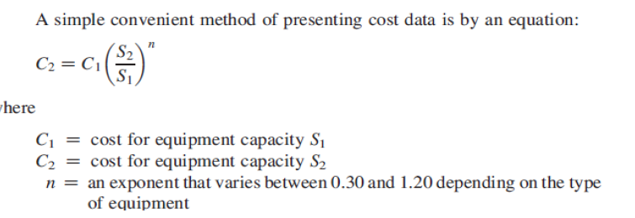

Slide 60
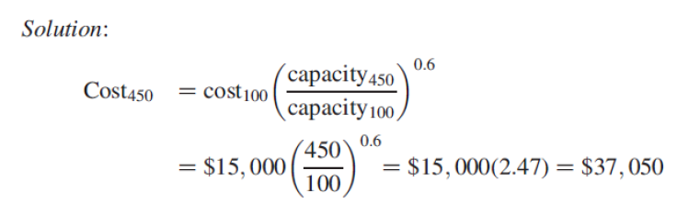
Example 4.1:Problem Statement: Recently a cast iron leaf pressure filter with 100 ft2 was purchased for clarifying an inorganic liquid stream for $15,000. In a similar application, the company will need a 450 ft2 cast iron leaf pressure filter. The size exponent for this type filter is 0.6 (see Appendix
D). Estimate the purchased price of the 450 ft2 unit.

Slide 61
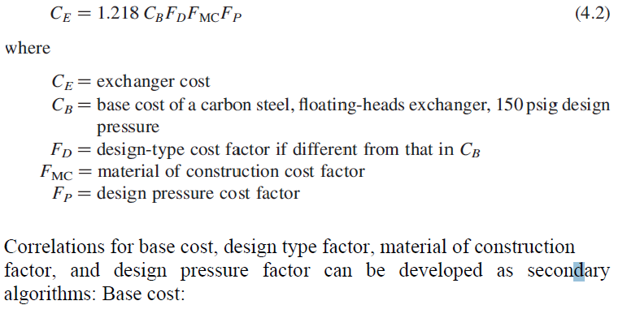
Algorithm Format. A more convenient way to display cost-capacity data is by an algorithm.

